Slide 1


Revolutionizing Banking:
AI & Automation at Itaú Bank
Transforming Human-Decision Models to AI-Driven Solutions
Presented by: Rodrigo Sena
September 2025
Notes:
Good afternoon everyone. My name is Rodrigo Sena, and today I’ll share how Itaú Bank is revolutionizing banking by shifting from human-decision models to AI-driven solutions. Our journey is about making banking faster, smarter, and more client-centric.

Slide 2

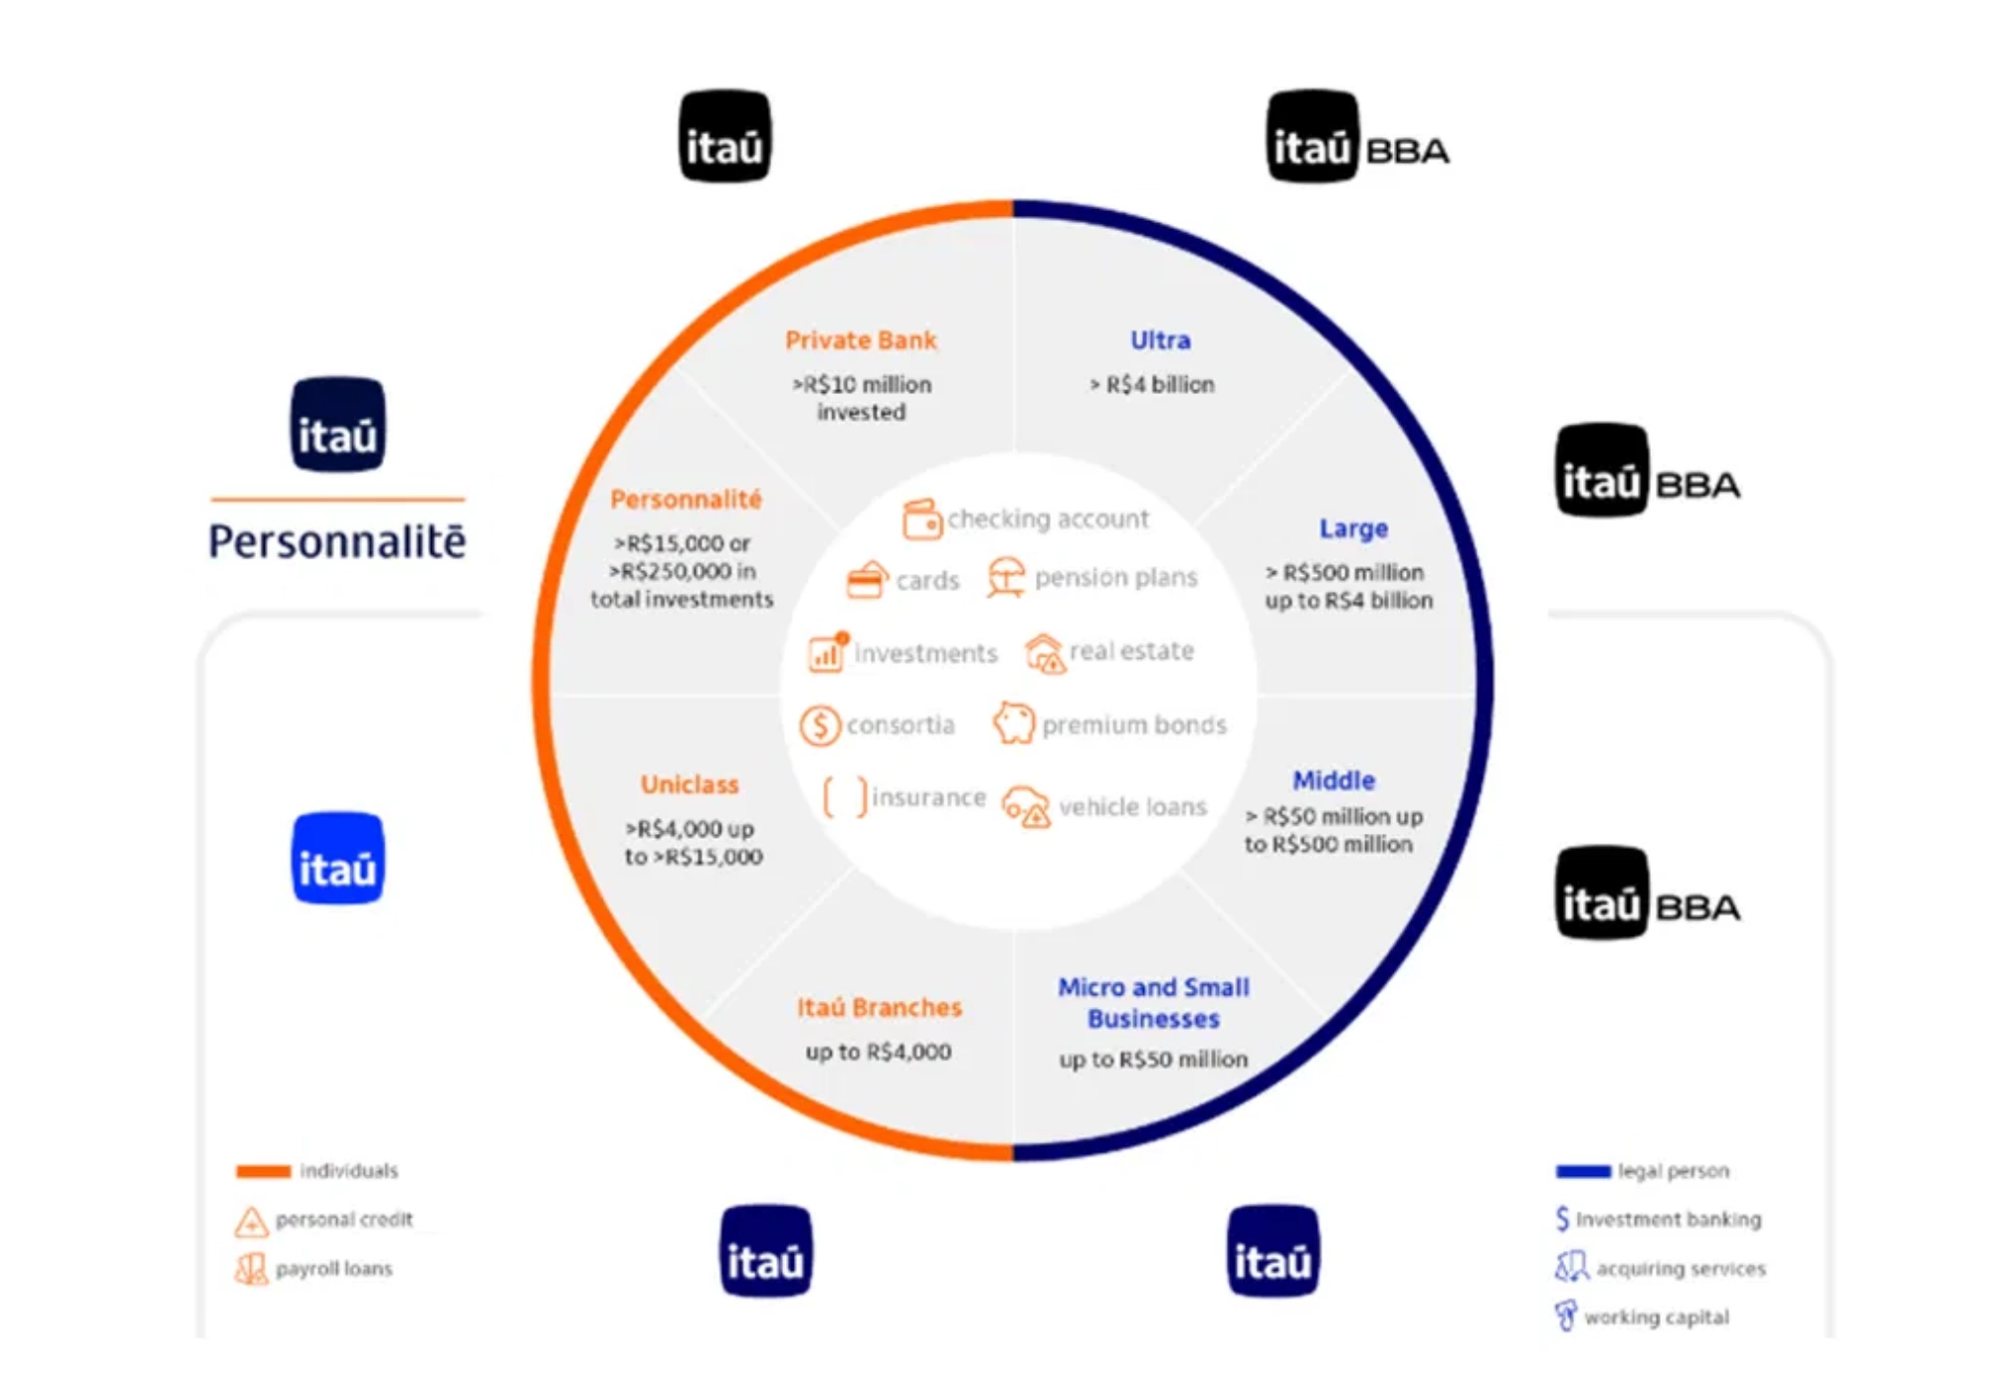


Introduction & Problem Statement
Itaú's current products and services offerings for
retail and corporate clients rely heavily on
human-decision models
, creating significant
challenges in today's digital banking landscape.
Current Challenges
Slow decision-making processes (avg. 72 hours)
Inconsistent customer experiences across channels
The banking industry is rapidly evolving, with
AI
High operational costs impacting client pricing
and automation
becoming key differentiators.
Limited personalization capabilities
Without transformation, Itaú risks losing market
share to more agile competitors and digital-first
challengers.
Notes:
Currently, many of Itaú’s products and services depend heavily on human decision-making. While this worked in the past, today it creates delays, high costs, and inconsistent client experiences. To stay competitive, we need to embrace AI and automation.
Decisions take on average 72 hours. Clients don’t get a consistent experience across channels. Costs remain high, limiting our ability to price competitively. And personalization is limited. Competitors who are digital-first are already moving faster. Transformation is not optional — it’s urgent.
individuals, = personal credit, payroll loans etc
Legal person = investment banking, acquiring services, working capital, etc

Slide 3
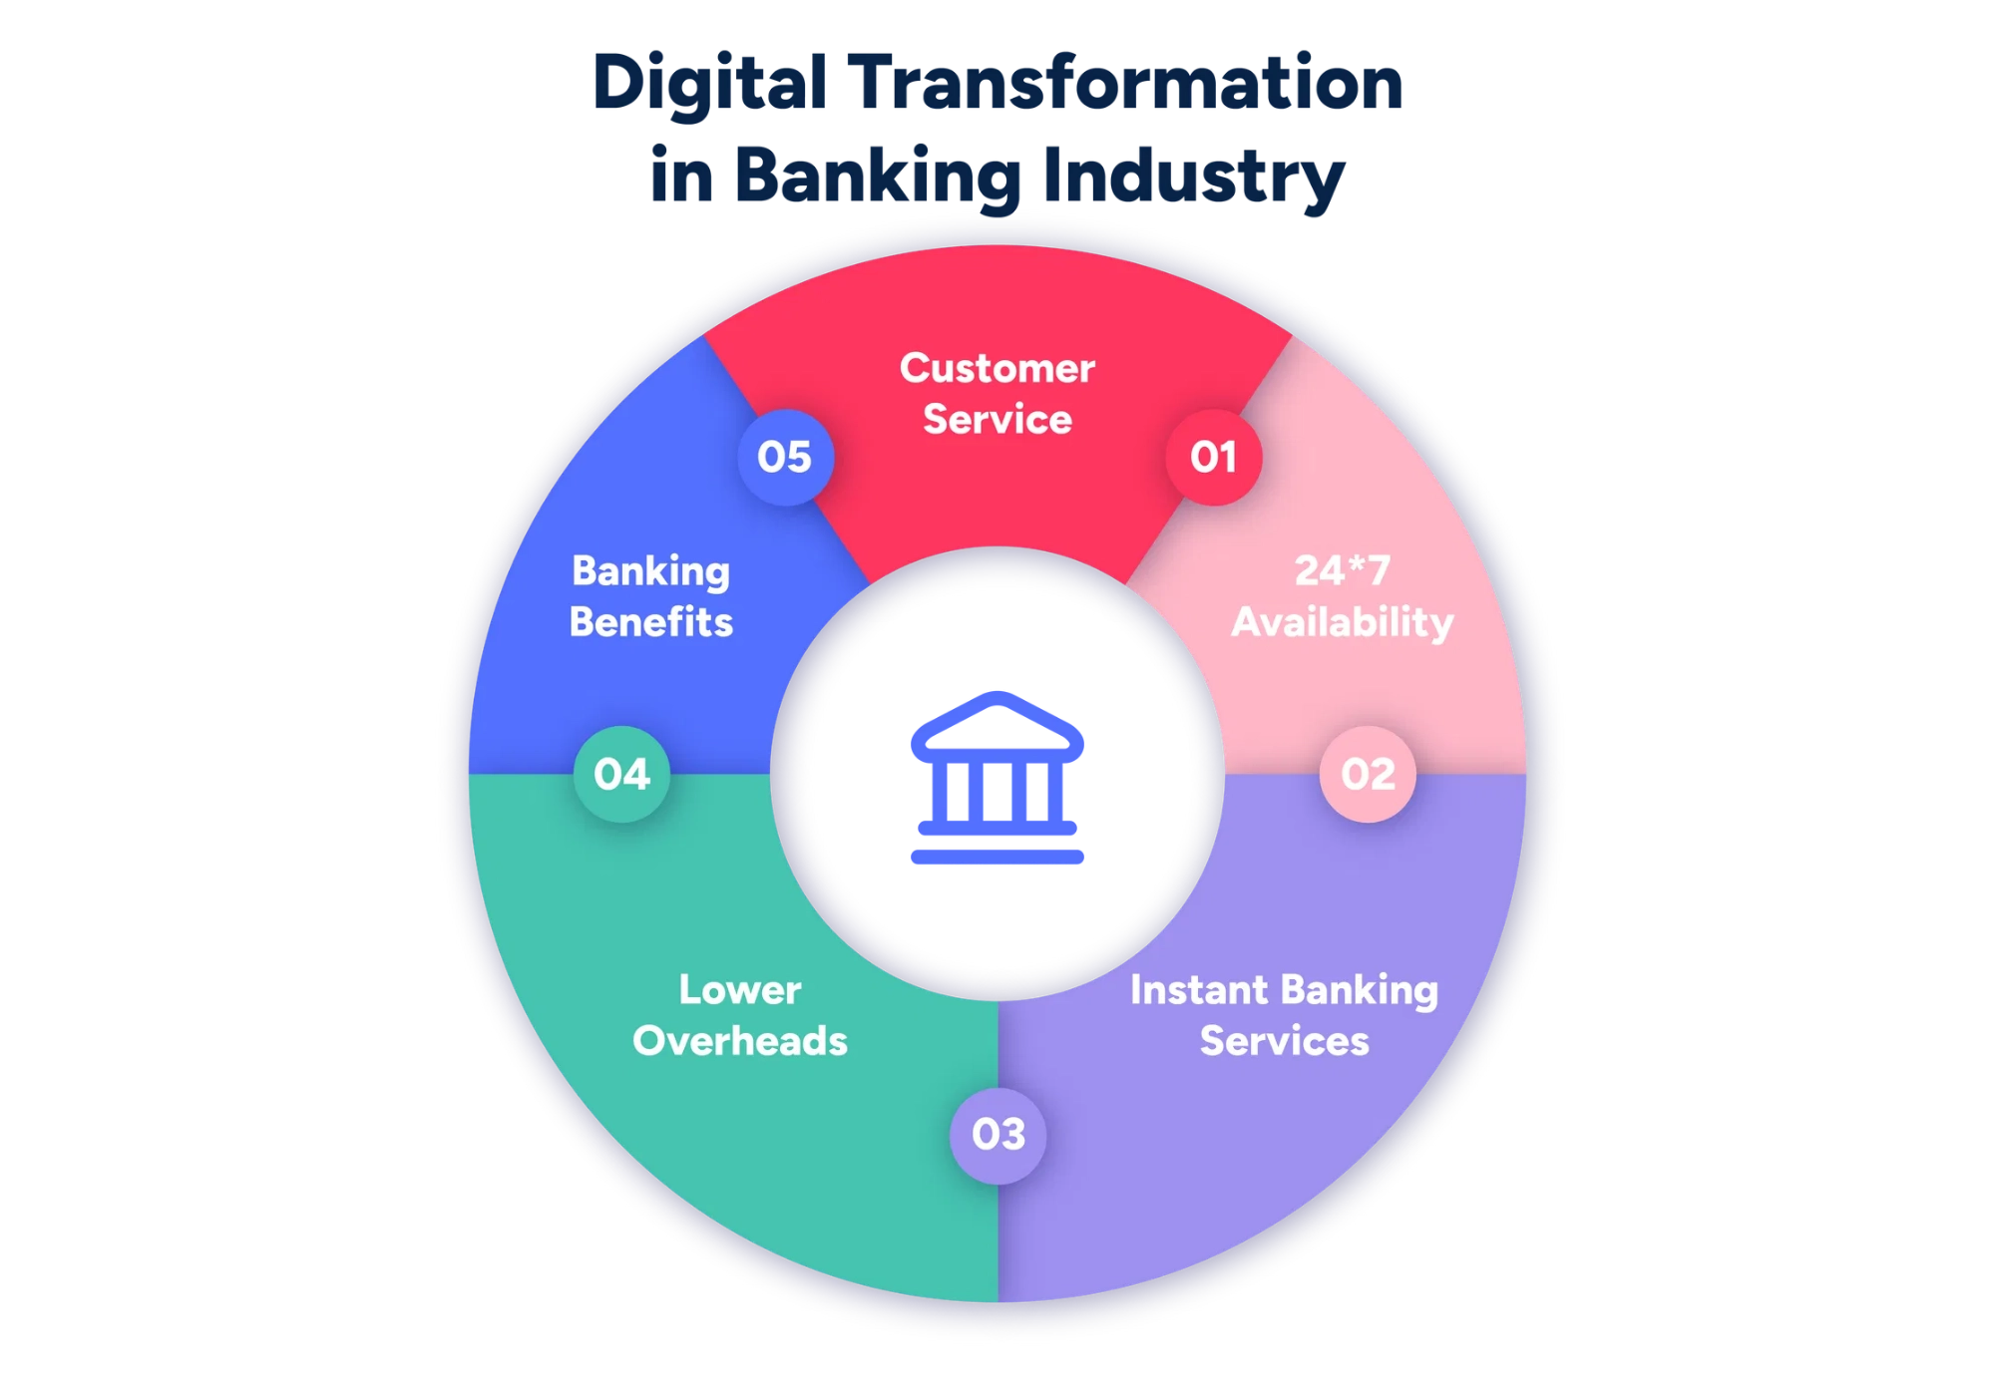



Our AI & Automation Strategy
Our comprehensive strategy leverages
cutting-
edge AI and automation
to transform Itaú's
product and service offerings for both retail and
corporate clients.
Intelligent Offer Engine
ML-powered personalized product recommendations based on client behavior and needs
Process Automation
RPA and workflow automation to streamline operations and reduce manual intervention
This transformation will enable
faster decisions
,
personalized experiences
, and
optimized pricing
Advanced Analytics
Real-time data analytics for risk assessment and decision-making
while maintaining Itaú's high standards for
security and compliance.
Notes:
Our strategy is to use AI and automation to redesign Itaú’s services for both retail and corporate clients. We are introducing an intelligent offer engine, process automation through RPA, and advanced analytics. The outcome? Faster decisions, personalized client experiences, and optimized pricing — all with Itaú’s traditional focus on security and compliance.

Slide 4
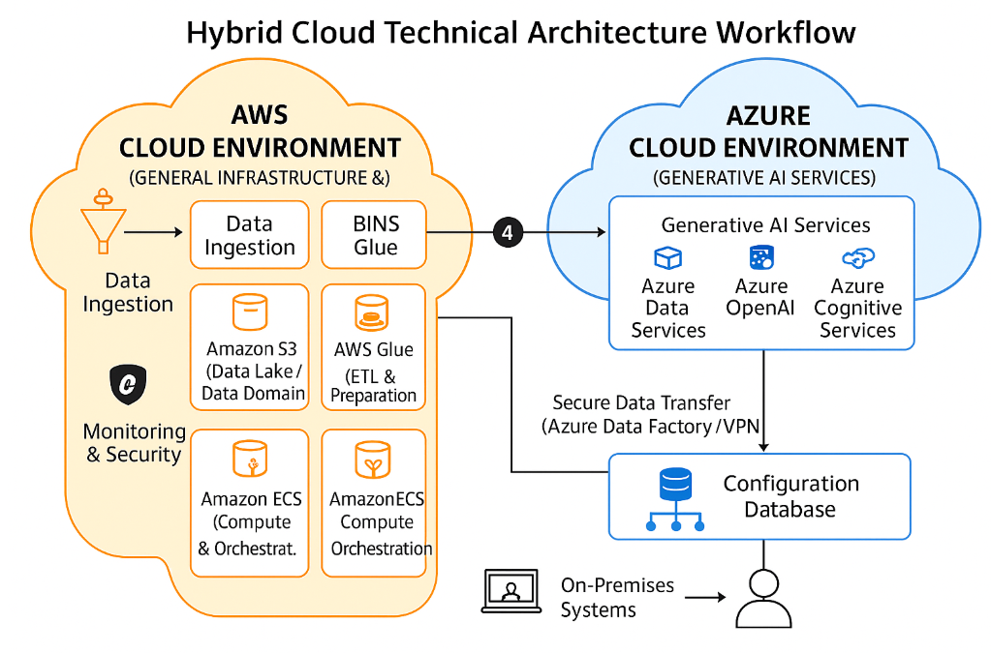



Technical Architecture & Implementation
Our technical architecture is designed for
scalability
,
security
, and
integration
with Itaú's
existing systems.
AI & Machine Learning
AWS
Glue
TensorFlow
PyTorch
Azure ML
AWS SageMaker
Data Processing
Apache Spark
Kafka
Snowflake
MongoDB
Security & Compliance
Vault
OAuth 2.0
LGPD Compliance
Encryption
Implementation follows a
phased approach
with
continuous integration and deployment,
ensuring minimal disruption to existing services
while enabling rapid innovation.
Notes:
The architecture was designed with scalability, security, and integration in mind. We use platforms like TensorFlow, PyTorch, Azure ML, and AWS SageMaker for AI; Spark, Kafka, Snowflake, and MongoDB for data; and strong compliance with LGPD and encryption. Implementation follows a phased approach with continuous deployment — ensuring fast innovation without disrupting services.

Slide 5
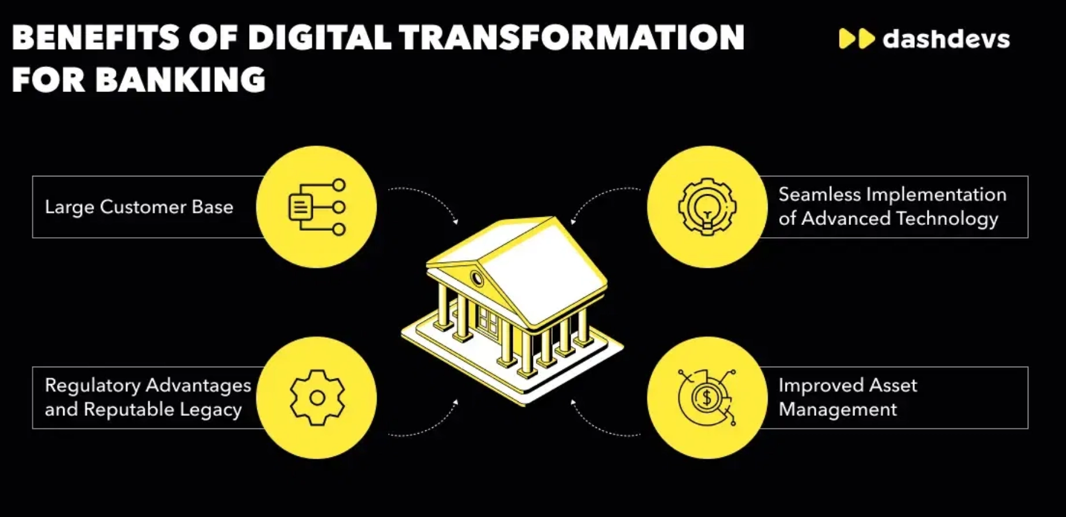
Navigating Challenges: Risk Management
Transforming to an AI-driven model presents
significant challenges
that require proactive
management and strategic planning.
Data Privacy & Regulatory Compliance
High
Ensuring AI systems comply with LGPD and banking regulations
Mitigation: Privacy-by-design approach and regulatory engagement
Legacy System Integration
Medium
Our
risk management framework
includes
continuous monitoring, regular stakeholder
Connecting AI solutions with existing core banking systems
reviews, and agile response mechanisms to
Mitigation: Phased implementation with API-first architecture
address emerging challenges.
Talent & Capability Gaps
Medium
We've established a dedicated
AI Ethics
Committee
Acquiring and retaining AI/ML expertise in competitive market
to ensure responsible AI deployment
across all customer-facing applications.
Mitigation: Strategic hiring, upskilling programs, and partnerships
Notes:
Of course, such a transformation comes with risks. Data privacy and regulatory compliance are critical. Integration with legacy systems requires careful planning. And there’s a war for AI talent. We mitigated these with privacy-by-design, API-first architecture, and talent programs. A dedicated AI Ethics Committee ensures responsible deployment across all services.

Slide 6
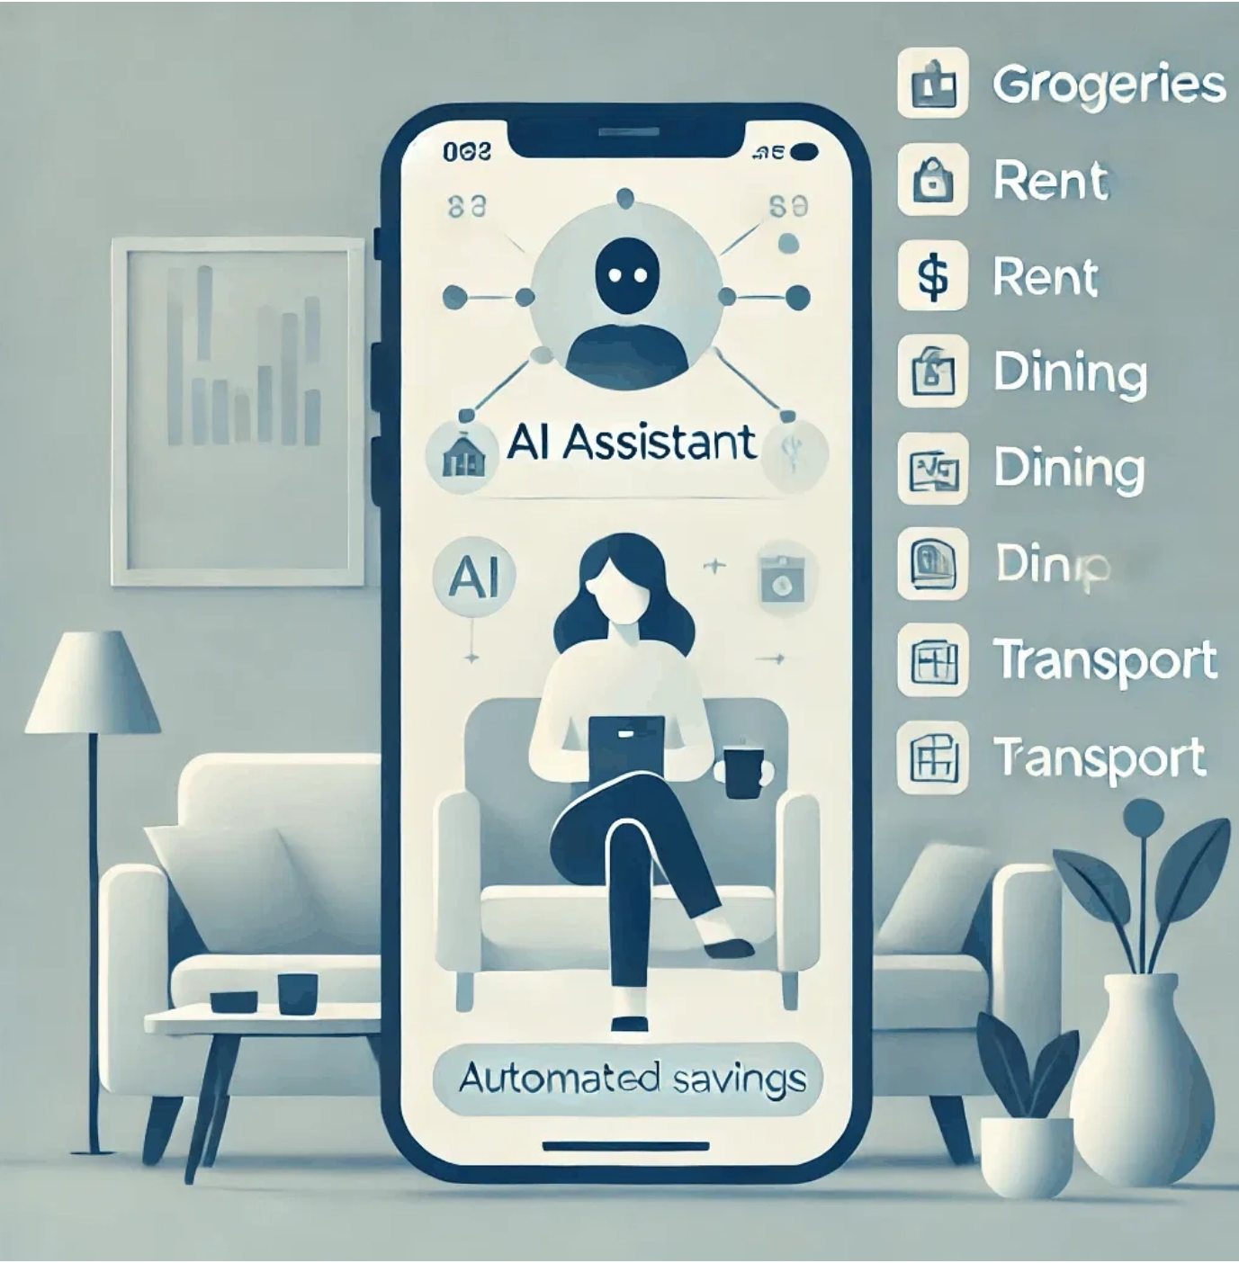



Leadership in Transformation
As
Project Manager of Delivery, AI & Data
, my role was
to guide this transformational journey, ensuring
alignment between technical capabilities and
business objectives.
Strategic Vision
Translating business goals into actionable technical roadmaps
Cross-Functional Collaboration
Bridging technical teams with business stakeholders
My leadership approach emphasizes
empowering teams
with the right tools and
knowledge while maintaining clear
accountability
Innovation Culture
for delivering measurable business outcomes.
Fostering experimentation and continuous learning
Notes:
As Project Manager for Delivery, AI & Data, my role was to guide this journey. That meant translating business goals into technical roadmaps, ensuring collaboration across teams, and building a culture of innovation. My approach focused on empowering teams, setting accountability, and ensuring measurable results.

Slide 7
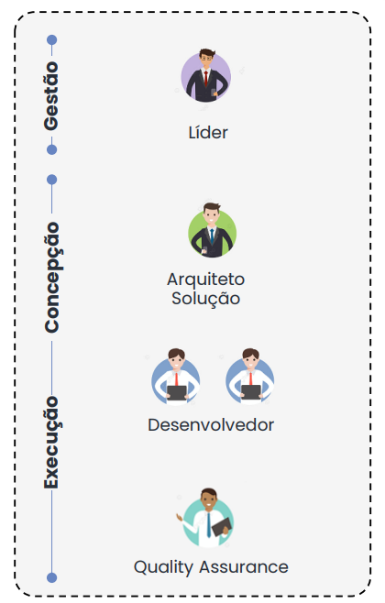
.
Team Structure
I considered a comprehensive structure, encompassing the project management and execution stages. Within the highlighted roles, we consider responsibilities such as:
Leader: Responsible for guiding the development team in implementing technological solutions, ensuring projects are completed on time and meeting technical and quality requirements. Responsible for defining the architecture and solution, working collaboratively with the team and providing technical supervision, as well as risk management and interaction with other project stakeholders.
Developers: Delivery team member, receives guidance from technical and functional leadership and translates requirements into technical products and software.
Testers: Overseeing the delivery process from its inception, ensuring a common understanding with other stakeholders and a broader repertoire for proposing test scenarios and use cases necessary for broad coverage and quality validation of the installed technical product.
manager
Leader/PM
conception
Architect
Dev Team
execution
High level workflow
Notes:
We structured the project with clear roles: leadership for guidance, developers for building, and quality teams for validation.

Slide 8
macro schedule
The illustrative model below provides for 1 week for discovery, 6 weeks for development, 2 weeks for testing/refining, documentation and homologation, and 2 weeks for deployment and assisted production. In total there will be 3 months for development and implementation + 1 month warranty.
#
Activities
Timeline
Month 1
Month 2
Month 3
W1 | W2 | W3 | W4
W1 | W2 | W3 | W4
W1 | W2 | W3 | W4 | W5
0
Kickoff
1
Discovery
2
Development
3
Unit Tests|Documentation
4
Homologation
PRD
5
Implantation
30 Days Warranty
6
Assisted Production
Management and Control
Notes:
We structured the project with clear roles: leadership for guidance, developers for building, and quality teams for validation. for 1 week for discovery, 6 weeks for development, 2 weeks for testing/refining, documentation and homologation, and 2 weeks for deployment and assisted production. In total there will be 3 months for development and implementation + 1 month warranty.
This ensured predictability and quality delivery.

Slide 9
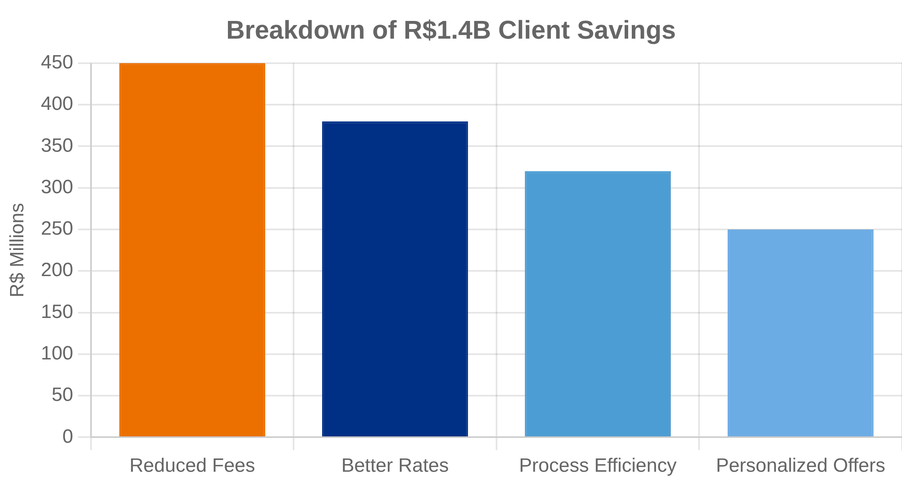



Delivering Tangible Value: R$1.4 Billion in Savings
Our AI and automation transformation delivered
significant value
to Itaú and its clients:
R$1.4 Billion in Client Savings
Faster Decision-Making
Reduce approval times from 72 hours to under 5 minutes
Enhanced Personalization
Increase offer relevance by 85% through AI-driven insights
Operational Efficiency
30% reduction in operational costs through automation
Notes:
The impact is clear: R$1.4 billion in client savings. Approval times reduced from 72 hours to under 5 minutes. 85% more relevant offers through AI-driven insights. And a 30% reduction in operational costs. These are not just numbers — they are improvements that clients and the business feel every day.

Slide 10




Client-Centric Approach
Our transformation is guided by a
client-first
philosophy
, ensuring that all AI and automation
initiatives deliver tangible value to Itaú's
customers.
Continuous Feedback Loops
Regular client panels and feedback mechanisms to refine AI models and offerings
Transparent Communication
Clear explanation of AI-driven decisions and recommendations
By aligning stakeholder expectations with project
objectives, we ensure
smooth adoption
of new
AI-powered services across all client segments.
Value Demonstration
Quantifiable metrics showing cost savings and improved service quality
“My goal wasn’t just to implement AI, but to create meaningful experiences that strengthen client relationships and trust in Itaú's Bank digital transformation."
Notes:
Everything we did was guided by a client-first philosophy. We set up continuous feedback loops, transparent communication on AI-driven decisions, and clear demonstrations of value. The goal was not just to implement AI, but to create meaningful experiences that build trust and strengthen relationships.

Slide 11


Conclusion & Next Steps
Itaú's Bank transformation from human-decision
models to
AI-driven solutions
represents a
pivotal shift in how we serve our clients and
operate our business.
R$1.4 billion in client savings through AI-powered efficiency
By embracing this transformation, Itaú will not
Enhanced personalization and faster decision-making
only maintain its market leadership but also set
new standards for
client-centric banking
in the
Proactive risk management and ethical AI deployment
digital age.
Notes:
In conclusion, this transformation shifts Itaú from human-decision models to AI-driven solutions — unlocking billions in client savings, faster and more personalized experiences, and responsible AI deployment. This positions Itaú not just to keep its leadership, but to set new standards for client-centric banking in the digital age

Slide 12


Q&A
Thank you for your attention
Notes:
Thank you for your attention. I’ll be happy to take your questions

